Slide 1

TWO TRICS TECHNICAL ANALYSES 2023
WAYNE SAYERS, DORSET COUNCIL
Notes:
In this presentation I am going to provide a summary of the method and results of two sets of TRICS technical analyses that have been undertaken this year.

Slide 2
TWO TRICS TECHNICAL ANALYSES IN 2023
Two technical analyses have been undertaken by TRICS so far in 2023.
Many ideas for technical studies come from users through our annual User Survey.
The two studies presented today are as follows:
  Fast Food Drive-Through Trip Generation Analysis 2023
  TRICS Vehicle Occupants Analysis for Selected Development Types 2023
Notes:
These two sets of analyses took place at the beginning of 2023. Such analyses are often the result of feedback that we receive from our users through our annual TRICS User Survey. Two types of research project are considered: those that involve using the TRICS system, and those that are partly or fully required to take place outside of TRICS. These two studies were undertaken solely using the TRICS database. They are “Fast Food Drive-Through Trip Generation Analysis 2023” and “TRICS Vehicle Occupants Analysis for Selected Development Types 2023”.

Slide 3

FAST FOOD DRIVE-THROUGH TRIP GENERATION ANALYSIS 2023
TRICS has been surveying fast food drive-through sites for many years (and multi-modal from 2000). It is a very popular land use.
Recently new data fields have been added to this sub-category.
By 2023 there were sufficient surveys to undertake this technical analysis.
Drive-through coffee shops are not yet sufficient in number in the database to join this analysis (these are also popular).
The aim was to provide clear, comparative data to our users without offering conclusions.
Notes:
Firstly, I will present the analysis of Fast-Food Drive-Through trip generation. TRICS has been surveying this type of development for many years (including in the multi-modal format from 2000 onwards), and data on drive-throughs is very popular amongst our users. We have recently enhanced the data contained within this sub-category, and by this year there were enough surveys to allow us to undertake this technical analysis. Although in more recent times we have introduced drive-through coffee shops, we found that there is currently insufficient data to include this sub-category in this study (coffee shops are also popular amongst our users). The aim of this study was to provide clear and comparative data without offering conclusions.

Slide 4
TRICS DEFINITION OF FAST FOOD DRIVE-THROUGHS (SUB-CATEGORY 06/D)
Single fast food outlet with a drive-through facility, with or without restaurant facilities. May be within a retail/leisure park, but the site details and survey should only include the fast food outlet (both drive-through and other facilities). Trip rates are calculated by Gross Floor Area, Employees, or Parking Spaces.
Notes:
Firstly, let’s define the 06/D land use TRICS sub-category of Fast Food Drive-Through, which is as follows. “Single fast food outlet with a drive-through facility, with or without restaurant facilities. May be within a retail/leisure park, but the site details and survey should only include the fast food outlet (both drive-through and other facilities). Trip rates are calculated by Gross Floor Area, Employees, or Parking Spaces).”

Slide 5
SITE SELECTION CRITERIA
All included surveys undertaken no earlier than 01/01/2000.
Analyses split between surveys during 2000-2011 and surveys during 2012-2022 (to obtain a comparison over time).
Analyses also split between weekdays (Mon-Fri) and weekend days (Sat-Sun).
Analyses also split between “Outer” location types and “Central” location types (noting that the survey sample was much smaller for the Central grouping, meaning that only one set of calculations for weekdays across 2000-2022 was possible).
Notes:
TRICS first examined the potential survey samples for this analysis to see how the data sets could be broken down to provide a good level of comparative data without too small data samples. It was decided that all included surveys would have been undertaken no earlier than 01/01/2000 to provide as modern a context as was possible. The sample would then be split between 2000-2011 and 2012-2022, to obtain a good comparison of trip generation data over time across two distinct periods. The analysis would also be split between weekdays and weekends, and between two sets of location type groupings, being an Outer grouping and a Central grouping. It should be noted that the survey sample was much smaller for the Central grouping, meaning that only one set of calculations for weekdays across 2000-2022 was possible for the Central sites.

Slide 6
SURVEY SAMPLES USED IN THE ANALYSIS
Notes:
Here you can see the survey samples that were obtained. Note that the Outer location type grouping consisted of Suburban Area, Neighbourhood Centre (excluding villages) and Edge of Town main TRICS location types, whilst the Central grouping includes Town Centre and Edge of Town Centre categories. It is recognised that there was one particularly small data set, being 4 surveys for the Saturday-Sunday 2000-2011 entry in Table 1. However, given the range of the analysis and the overall average of sample sizes, this is not considered an anomaly significant enough to compromise the robustness of the results in this study. It is also not considered significant enough to exclude the selection criteria splits already mentioned. You can also see on this slide a quick visual guide to the various TRICS main location types.

Slide 7
METHOD OF CALCULATIONS
All trip rates to be calculated by 100m2 Gross Floor Area.
All trip rates would be by Total Vehicles (inclusive of all 7 TRICS standard vehicle classifications – insufficient data for a multi-modal analysis).
Two-way trip rates (arrivals plus departures) to be presented for the 0700-2200 period for each set of calculations.
Trip rates for peak arrivals and departures periods also to be presented (plus total two-way peak periods).
Notes:
Having obtained sufficient survey samples, the method of calculations was then decided. All trip rates would be calculated by 100m2 Gross Floor Area, and they would be calculated for the Total Vehicles count (inclusive of the 7 standard TRICS vehicle type classifications). Note that there was insufficient data to undertake a multi-modal analysis for this study. Two-way (arrivals plus departures) trip rates would be presented for the 0700-2200 period for each set of calculations, along with trip rates for peak arrivals and departures periods (plus total two-way peak periods).

Slide 8
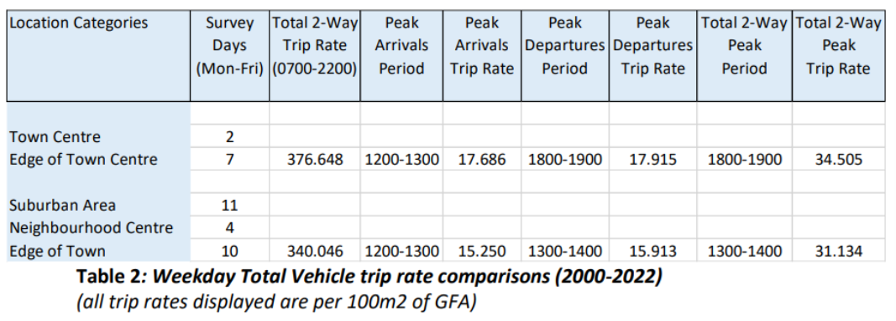
COMPARATIVE RESULTS
There are 6 sets of tabular results contained within the technical report.
Each table shows trip rates for the 0700-2200 survey period and peak periods.
Each set of 2 tables cover surveys undertaken in 2000-2022, 2000-2011 and 2012-2022. This example shows weekdays during 2000-2022.
Notes:
The technical report of this study includes 6 sets of tabular results. Each of these shows trip rates for the 0700-2000 survey period and peak periods, and they are split between two tables (one for weekdays and the other for weekend days) covering surveys (i.e., those undertaken throughout the 2000-2022 period of the study), surveys undertaken during 2000-2011, and surveys undertaken during 2012-2022. An example is shown on this slide, which displays the results for weekdays during 2000-2022. As you can see, the Central and Outer location type groupings are shown, followed by the various trip rates and survey periods. The first results we can see are the total two-way trip rates for 0700-2200, which show 377 trips per 100m2 of GFA for the Central grouping compared to 340 trips for the Outer grouping.

Slide 9
OBSERVATIONS
TRICS does not provide any explanations, suggestions or reasoning behind any of the results.
Single comparison between Outer and Central location type groupings was 2000-2022 (Mon-Fri). Two-way 0700-2200 trip rates were 340 trips per 100m2 GFA for the Outer grouping compared to 376 trips for the Central grouping, a difference of 10.8%.
All other comparisons were for the Outer grouping only due to sample sizes.
Notes:
When it comes to the observations provided by TRICS, it should be made clear that TRICS does not provide any explanations, suggestions or reasoning behind any of our results, as this is where we hand things over to our users to exercise their own professional judgement. However, TRICS has provided some key observations to assist users in this process. There was just a single comparison between the Outer and Central location type groupings (due to limitations in the Central sample size), this being within the weekday analysis for all surveys undertaken from 2000 until 2022. Two-way trip generation was 340 trips per 100m2 GFA for the Outer grouping compared to 376 trips for the Central grouping, a difference of 10.8%. All other comparisons were for the Outer grouping.

Slide 10
WEEKDAY/WEEKEND COMPARISONS
(OUTER LOCATION GROUPING)
2000-2022
  Overall period trip rates (0700-2200) were 340 per 100m2 GFA on weekdays and 549 on weekend days (61.5% higher at weekends).
2000-2011
  Overall period trip rates were 274 on weekdays and 402 on weekend days (46.5% higher at weekends).
2012-2022
  Overall period trip rates were 375 on weekdays and 660 on weekend days (76.1% higher at weekends).
Notes:
The technical report provides greater detail in its observations (including peak period comparisons), but here we can see the findings of the calculations for overall period trip rates (0700-2200). For 2000-2022, the trip generation for the overall survey period showed 340 trips per 100m2 of GFA on weekdays compared to 549 at weekends, so the rates were 61.5% higher at weekends. For the 2000-2011 surveys the trip rates were 274 on weekdays and 402 at weekends (again higher for weekends by 46.5%), and for 2012-2022 the trip rates were 375 on weekdays and 660 on weekends (so 76.1% higher at weekends).

Slide 11
WEEKDAY COMPARISONS OVER TIME
(OUTER LOCATION GROUPING)
The total two-way weekday trip rate for the 0700-2200 period has grown from 272 per 100m2 of GFA during 2000-2011 to 374 during 2011-2022, an increase of 36.6%
Notes:
Table 8 in the report displays the weekday Outer location type grouping comparison for the 2000-2011 surveys compared to the 2012-2022 surveys, with trip rates also shown for the overall 2000-2022 surveys. We can see that the total two-way weekday trip rate has grown from 272 per 100m2 of GFA during 2000-2011 to 374 during 2011-2022, which is an increase of 36.6%. There are also increases over time across all weekday peak period calculations, with the total two-way peak period trip rate increasing by 23.8%.

Slide 12
WEEKEND COMPARISONS OVER TIME
(OUTER LOCATION GROUPING)
The total two-way weekend trip rate for the 0700-2200 period has grown from 402 per 100m2 of GFA during 2000-2011 to 660 during 2011-2022, an increase of 64.2%
Notes:
Table 9 in the report displays the weekend Outer location type grouping comparison for the 2000-2011 surveys compared to the 2012-2022 surveys, with trip rates also shown for the overall 2000-2022 surveys. We can see that the total two-way weekday trip rate has grown from 402 per 100m2 of GFA during 2000-2011 to 660 during 2011-2022, which is an increase of 64.2%. There are also increases over time across all weekend peak period calculations, with the total two-way peak period trip rate increasing by 20.7%. This concludes the brief summary of this technical analysis.

Slide 13
TRICS VEHICLE OCCUPANTS ANALYSIS
FOR SELECTED DEVELOPMENT TYPES 2023
TRICS first surveyed Vehicle Occupants when the first multi-modal surveys commenced in 2000.
In 2008 the Vehicle Occupants mode split pie chart slice was sub-split between Single Vehicle Occupants and Multi-Vehicle Occupants.
The Vehicle Occupants count provides a good indication of numbers of people per vehicle and potential car-sharing.
The aim of this analysis was to provide clear Vehicle Occupants trip generation data across different land use types to our users without offering conclusions.
Notes:
We are now going to look at the technical analysis of Vehicle Occupants trip rates for selected development types. This is another study that was undertaken at the beginning of this year. TRICS first introduced the Vehicle Occupants count type when multi-modal surveys were first undertaken in 2000, along with the new Pedestrian and Public Transport User counts. The multi-modal counts evolved, and in 2008 the Vehicle Occupants mode split was sub-split into slices for Single Vehicle Occupants (i.e., single occupants of vehicles) and Multi-Vehicle Occupants (i.e., occupants of vehicles where there were at least 2 occupants in a vehicle). The Vehicle Occupants count provides a good indication of numbers of people per vehicle and, in turn, potential car-sharing. The aim of this analysis was to provide clear Vehicle Occupants trip generation data across different land use types for our users without offering any conclusions.

Slide 14
DEFINING THE VEHICLE OCCUPANTS COUNT
The Vehicle Occupants count in TRICS includes all occupants of vehicles (except coach and bus passengers) but excludes drivers of vehicles picking up/dropping off passengers.
The count splits vehicles with 1 occupant, 2 occupants… up to 7 occupants.
Example 1: Vehicle arrives with a driver plus 1 passenger, both visiting the site (1 Vehicle arrival and 2 Vehicle Occupant arrivals).
Example 2: Vehicle arrives and departs, the driver dropping off 1 passenger visiting the site (1 Vehicle arrival, 1 Vehicle departure, and 1 Vehicle Occupant arrival).
Notes:
Before we go into the process of this study, let’s first define what the TRICS Vehicle Occupants count is. The Vehicle Occupants count includes all occupants of vehicles visiting a site (except coach and bus passengers who are dealt with separately) but excludes drivers of vehicles that are picking up or dropping off passengers at a site (i.e., not physically visiting the site themselves). The count is split between vehicles with 1 occupant, 2 occupants and so on, up to 7 occupants. From this, the total number of vehicle occupants by direction and survey period is calculated. We can give two examples of how this works. In Example 1, a vehicle arrives with a driver plus 1 passenger, both of whom visit the site. This inbound movement equates to 1 vehicle arrival plus 2 vehicle occupant arrivals. As the vehicle and occupants later leave the site, the outbound trips will be recorded. In Example 2, a vehicle arrives and departs the site, with the driver dropping off 1 passenger. In such a case, 1 vehicle arrival and 1 vehicle departure is recorded, with 1 vehicle occupant (the passenger) recorded as arriving at the site. This demonstrates clearly the principle of excluding pick-up drop off drivers in TRICS surveys wherever this as possible.

Slide 15
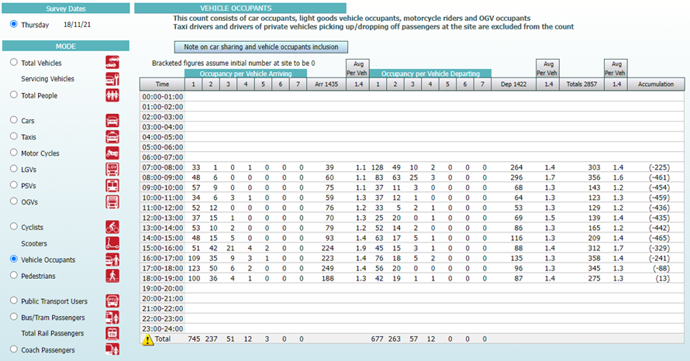
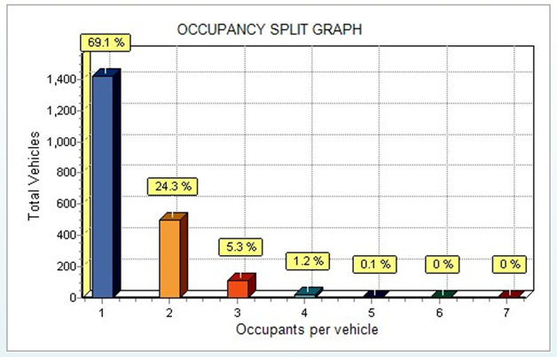
THE VEHICLE OCCUPANTS COUNT
& OCCUPANCY SPLIT GRAPH IN TRICS
IMPORTANT: Note that the number of vehicles (bottom of table) may not equal the corresponding numbers in the Total Vehicles count, as drivers with zero occupants are not included in the Vehicle Occupants count.
Notes:
The Vehicle Occupants count is presented in TRICS in a unique way. Here we can see an example. The number of vehicles with 1, 2, 3 occupants etc are shown vertically, with the total number of vehicle occupants then calculated under the Arrivals, Departures and Totals columns respectively. Note that the average number of occupants per vehicle are also shown in further columns. You can also see at the bottom of the table that the total number of vehicles with occupants is displayed as the final row of data. It is very important to recognise that these figures in the lowest row may not equal the corresponding numbers in the separate Total Vehicles count, as drivers with zero occupants are not included in the Vehicle Occupants count. Again, we go to the second Example that was given. If a driver leaves a site after dropping someone off, then although that vehicle will be included as a departure in the Total Vehicles count, it will technically (by the rules of TRICS) have zero occupants (the driver undertaking the drop-off being excluded from the Vehicle Occupants count), and therefore this vehicle will not be represented in the Vehicle Occupants count. A detailed note on this is accessible via the button you can see above the table called “Note on car sharing and vehicle occupants inclusion”. The second image on the right of this slide also shows a graphical representation of the Vehicle Occupants count, which can be accessed by clicking on the “Occupancy Split” icon when viewing any individual multi-modal survey, showing a handy comparison of the number of occupants by vehicle.

Slide 16
SURVEY SAMPLES & METHOD OF ANALYSIS
All included surveys undertaken no earlier than 01/01/2008, to ensure that Single Vehicle Occupants and Multi-Vehicle Occupants could be split in mode split pie charts.
All analyses to be weekdays (Monday-Friday) only (insufficient data for weekends).
Analyses also split between “Outer” location types and “Central” location types.
Notes:
Let’s now look at the survey samples and method of analysis used in this study. TRICS needed to ensure that useable survey samples were achieved, so a balance was required between the number of variables introduced and the number of surveys ending up in each split. The database was sufficient in size to provide this balance. As we needed to show splits between Single Vehicle Occupants and Multi-Vehicle Occupants, only surveys undertaken from 01/01/2008 were included, as this was when this sub-split was first introduced. All analyses would include only weekdays, as there was insufficient weekend survey data (and weekend surveys would only have been relevant for a small number of land use sub-categories in the study). Like the previous technical analysis, the surveys were also split between the “Outer” and “Central” location type groupings.

Slide 17
LAND USES AND SURVEY SAMPLES
Trip rates to be calculated by GFA other than the following sub-categories:
  03/A (per 1 dwelling)
  03/C (per 1 dwelling)
  07/C (per 1 hectare of site area)
Notes:
Table 1 in the technical report shows the TRICS land use sub-categories that were included in this study (8 in total), along with the number of surveys in each sub-category, split by the Central and Outer location type groupings, sub-split by the TRICS main location types. It needs to be noted that the trip rates could not be presented in a “like-for-like” way, as for some of the land uses different trip rate calculation parameters had to be used. Most of the land uses had trip rates calculated per 100m2 of GFA, but for the two residential sub-categories the trip rates were calculated per 1 Dwelling, and for the Leisure Centre sub-category the trip rates were calculated per 1 Hectare of Site Area (given that at such sites there is often outdoor space such as pitches etc).

Slide 18
NOTES ON SURVEY SAMPLES
There were only 2 Town Centre surveys for 01/C (Discount Food Store), with 18 being Edge of Town Centre.
There were no Town Centre surveys for 03/A (Houses Privately Owned), with all 18 being Edge of Town Centre.
The vast majority of 03/A surveys were within the Outer location types grouping.
There were only 2 Town Centre surveys for 05/G (GP Surgery), with 13 being Edge of Town Centre.
We do not consider that any of these points compromise the validity of the results.
Notes:
There are some points to note regarding the survey samples used in this analysis. There were only 2 Town Centre surveys for 01/C (Discount Food Store), with 18 being Edge of Town Centre. There were no Town Centre surveys for 03/A (Houses Privately Owned), with all 18 being Edge of Town Centre. The vast majority of 03/A surveys were within the Outer location type grouping, and there were only 2 Town Centre surveys for the 05/G (GP Surgery) sub-category, with 13 being Edge of Town Centre. However, TRICS does not consider that any of these points compromise the validity of the results of this series of analyses, but nonetheless it is worth mentioning them.

Slide 19
METHOD OF CALCULATIONS
Trip rates to be calculated (where possible) using GFA (with exceptions previously noted).
Vehicle Occupants trip rates to be calculated separately for Central and Outer location type groupings. Total survey duration trip rates to be presented first.
Total Vehicles and Total People trip rates also calculated for additional context.
Notes:
Now let’s look at the method of calculations for this study. It was decided that the following method would be used. Trip rates would be calculated using GFA wherever possible and appropriate, with the exceptions already noted for 3 of the 8 land use sub-categories. Vehicle Occupants trip rates would be calculated separately for the Central and Outer location type groupings. In each case, the total survey duration trip rates (covering the earliest start time to the latest finish time for each separate set of surveys) would be presented first. Total Vehicles and Total People trip rates would also be calculated for each set of surveys to provide some additional context and comparative information.

Slide 20
METHOD OF CALCULATIONS
Vehicle Occupants to then be divided by Total Vehicles to provide some further context. CAVEAT: Vehicles in the Vehicle Occupants count will not necessarily match the vehicles in the Total Vehicles count (as explained before), so the ratio calculated will NOT show the average number of occupants per vehicle.
Two-way Vehicle Occupants peak hour trip rates also to be presented. CAVEAT: For every set of surveys this peak period needs to have trip rates present for every survey, otherwise it cannot be shown as the peak hour (to avoid any misleading weighting or bias).
Notes:
The Vehicle Occupants were to then be divided by Total Vehicles in each data set to provide further context. However, this comes with an important caveat. Vehicles in the Vehicle Occupants count will not necessarily match the vehicles in the Total Vehicles count. As previously explained, this is due to the exclusion of drivers picking up/dropping off people at sites, and vehicles with “zero occupancy” therefore being excluded from the vehicles shown in the Vehicle Occupants Count (but included in the Total Vehicles count). Therefore, the ratio calculated will NOT show the average number of occupants per vehicle. The total two-way (arrivals plus departures) Vehicle Occupants peak hour trip rates would then also be presented. Again, we have an important caveat here. For every set of surveys this peak period would need to have trip rates present for every survey, otherwise it could not be shown as the peak hour. This is to avoid any potential misleading weighting and bias in the results. For example, if there were 26 surveys in a data set, but the two-way peak period represented only 2 surveys (say right at the end of the survey, noting that individual survey start and finish times often differ), then this would not be selected as the peak hour. Instead, the period with the highest two-way trip rates where all 26 surveys were included in the average would be displayed.

Slide 21
METHOD OF CALCULATIONS
Average Vehicle Occupants mode split percentages (arr+dep) to be presented for each set of surveys, split between Single Vehicle Occupants and Multi-Vehicle Occupants. CAVEAT: Average mode split pie charts can only be calculated using trip rates for the period where data is available for every survey in a selected set.
After each set of sub-category results is presented, a combined comparative summary table across the categories will be presented.
Notes:
Average Vehicle Occupants mode split percentages (arrivals plus departures) would also be presented for each set of surveys, split between Single Vehicle Occupants and Multi-Vehicle Occupants, and taken from the average mode split pie charts for each set. The sum of the two percentages would then be displayed, representing the total Vehicle Occupants mode split percentage. Another caveat is required here. Average mode split pie charts in TRICS can only be calculated using trip rate figures for the period where data is available for every survey in a selected set. For example, if there are 26 surveys in a selected set, and trip rate data is only available for all 26 surveys for the period 0800-2000, then the two-way total mode split percentages will only include that period. If, for example, there were 20 surveys with data available for the 2000-2100 period, then this data would be excluded from the mode split percentage calculation. Finally, after each set of sub-category results was presented, a combined comparative summary table across the categories would be shown.

Slide 22
COMPARATIVE RESULTS
There are 8 initial sets of tabular results contained within the technical report, one for each land use sub-category.
Each table shows trip rates for the full survey duration, along with peak hour trip rates and Vehicle Occupants mode splits (example shown for 02/A – Office), with all results split by the two location type groupings.
Notes:
The technical report of this study includes 8 initial sets of tabular results, one for each land use sub-category. Each of these shows trip rates for the full survey duration and the total two-way peak hour. As you can see, the Central and Outer location type groupings are shown, followed by the various trip rates and survey periods. The results we can see in this example for the 02/A (Office) sub-category are the full survey duration two-way trip rates, which show 7.2 trips per 100m2 of GFA for the Central grouping compared to 11.2 trips for the Outer grouping. You can also see that after the various trip rates are displayed there are mode split percentages shown for Single Vehicle Occupants, Multi Vehicle Occupants, and Total Vehicle Occupants.

Slide 23
COMPARATIVE RESULTS
Table 10 is a comparison of the land use sub-categories.
Notes:
Following the separate tables in the report for the individual sub-categories, Table 10 displays a single table for comparison purposes. This table displays Vehicle Occupants divided by Total Vehicles, the identification of the two-way total peak hour period, and the Vehicle Occupants mode splits, again shown for Single Vehicle Occupants, Multi Vehicle Occupants and Total Vehicle Occupants. Having these results in a single table provides a quick and easy comparison of these mode splits across a good variety of development types.

Slide 24
OBSERVATIONS
TRICS does not provide any explanations, suggestions or reasoning behind any of the results.
Numerous observations are made by land use sub-category based on the results tables and are detailed in the report. One of these, the full survey duration Vehicle Occupants trip rate comparisons by Central and Outer location type groupings, are as follows:
01/A (Food Superstore): Trip rate by 100m2 GFA was 16.3% lower for the Central grouping (109.6) than for the Outer grouping (127.5).
01/C (Discount Food Store): Trip rate by 100m2 GFA was 0.7% lower for the Central grouping (141.3) than for the Outer grouping (142.2).
Notes:
As per the previous technical analysis, when it comes to the observations provided by TRICS, it should be made clear that TRICS does not provide any explanations, suggestions or reasoning behind any of our results, as this is where we hand things over to our users to exercise their own professional judgement. However, TRICS has provided some key observations to assist users in this process. The technical report provides a variety of observations by land use sub-category. Here we can see one example, being the findings of the calculations for trip rates over the total survey period, comparing the Central and Outer location type groupings. For the 01/A (Food Superstore) sub-category, the trip rate by 100m2 of GFA for the Central location type grouping (109.6) was 16.3% lower than for the Outer grouping (127.3). For 01/C (Discount Food Store) the trip rate by 100m2 of GFA for the Central grouping (141.3) was 0.7% lower than for the Outer grouping (142.2).

Slide 25
OBSERVATIONS
02/A (Office): Trip rate by 100m2 GFA was 57.0% lower for the Central grouping (7.2) than for the Outer grouping (11.2).
03/A (Houses Privately Owned): Trip rate by 1 Dwelling was 5.5% lower for the Central grouping (6.7) than for the Outer grouping (7.1).
03/C (Flats Privately Owned): Trip rate by 1 Dwelling was 17.0% lower for the Central grouping (2.5) than for the Outer grouping (3.0).
Notes:
For 02/A (Office) the trip rate by 100m2 of GFA for the Central grouping (7.2) was 57.0% lower than for the Outer grouping (11.2). For 03/A (Houses Privately Owned) the trip rate per 1 Dwelling for the Central grouping (6.7) was 5.5% lower than for the Outer grouping (7.1). For 03/C (Flats Privately Owned) the trip rate per 1 Dwelling for the Central grouping (2.5) was 17.0% lower than for the Outer grouping (3.0).

Slide 26
OBSERVATIONS
05/G (GP Surgery): Trip rate by 100m2 GFA was 29.0% lower for the Central grouping (53.1) than for the Outer grouping (68.5).
06/A (Hotel): Trip rate by 100m2 GFA was 63.8% lower for the Central grouping (7.4) than for the Outer grouping (12.1).
07/C (Leisure Centre): Trip rate by 1 Hectare of Site Area was 29.0% lower for the Central grouping (598.8) than for the Outer grouping (772.7).
Other observations include Vehicle Occupants divided by Total Vehicles, and mode splits of Single Vehicle Occupants, Multi-Vehicle Occupants and Total Vehicle Occupants (again comparing the Central and Outer location type groupings).
Notes:
For 05/G (GP Surgery) the trip rate by 100m2 of GFA for the Central grouping (53.1) was 29.0% lower than for the Outer grouping (68.5). For 06/A (Hotel) the trip rate by 100m2 of GFA for the Central grouping (7.4) was 63.8% lower than for the Outer grouping (12.1). For 07/C (Leisure Centre) the trip rate per 1 Hectare of Site Area for the Central grouping (598.8) was 29.0% lower than for the Outer grouping (772.7). Other observations available within the report include Vehicle Occupants divided by Total Vehicles, and mode splits of Single Vehicle Occupants and Multi-Vehicle Occupants (plus Total Vehicle Occupants), again comparing the Central and Outer location type groupings.

Slide 27
SINGLE/MULTI-VEHICLE OCCUPANTS
MODE SPLITS
Highest overall Vehicle Occupants mode split was Outer grouping for 01/A (Food Superstore) at 87.0%
Lowest overall Vehicle Occupants mode split was Central grouping for 02/A (Office) at 31.9%.
Notes:
We can also see a graphical representation of the Vehicle Occupants mode split breakdown by land use sub-category in the image on the left of this slide. As you can see, it is split by Single Vehicle Occupants and Multi Vehicle Occupants and is available as Figure 3 in the technical report. The right image shows Table 11 of the report, which displays the Vehicle Occupants total mode split percentages ranked in descending order for each calculation made (16 in total, consisting of the Central and Outer location type groupings for each of the 8 land use sub-categories). You can also see the Single Vehicle Occupant and Multi Vehicle Occupant mode splits alongside the ranked total Vehicle Occupants mode split. As you can see, the data set with the highest overall Vehicle Occupants mode split was the Outer grouping for 01/A (Food Superstore) at 87.0% of all people trips. The data set with the lowest overall Vehicle Occupants mode split was the Central grouping for 02/A (Office) at 31.9% of all people trips.

Slide 28
TECHNICAL REPORTS AVAILABLE IN TRICS VERSION 7.10.2
Both technical reports will be available in TRICS version 7.10.2 (release date 30th June 2023).
Reports will be freely accessible within the TRICS Library module.
Notes:
This concludes the summaries for these two TRICS technical analyses. Both technical reports will be included and freely accessible in the TRICS Library module upon the release of TRICS version 7.10.2, which goes live on the 30th of June 2023.

